Slide 1

PROJECT OVERVIEW
& INTRO TO GROUNDTRUTH
EASY
ADVANCED

Slide 2
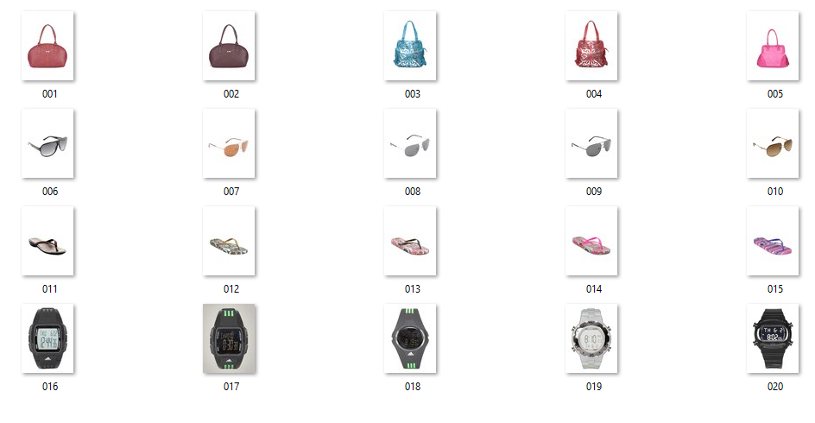
PROJECT OVERVIEW
In this project, we will learn how to label images using Amazon SageMaker GroundTruth.
These are the key learning outcomes:
The need for labelled datasets
Applications of supervised learning
Challenges of obtaining labelled datasets
Learn how to define a labeling job using Amazon SageMaker Groundtruth
Learn how to label data in Amazon SageMaker Groundtruth
Understand the concept of JsonL and manifest files
20 IMAGES BELONGS TO 4 CLASSES (BALANCED DATASET)
BAGS
EYEWEAR
FLIPFLOPS
WATCHES

Slide 3
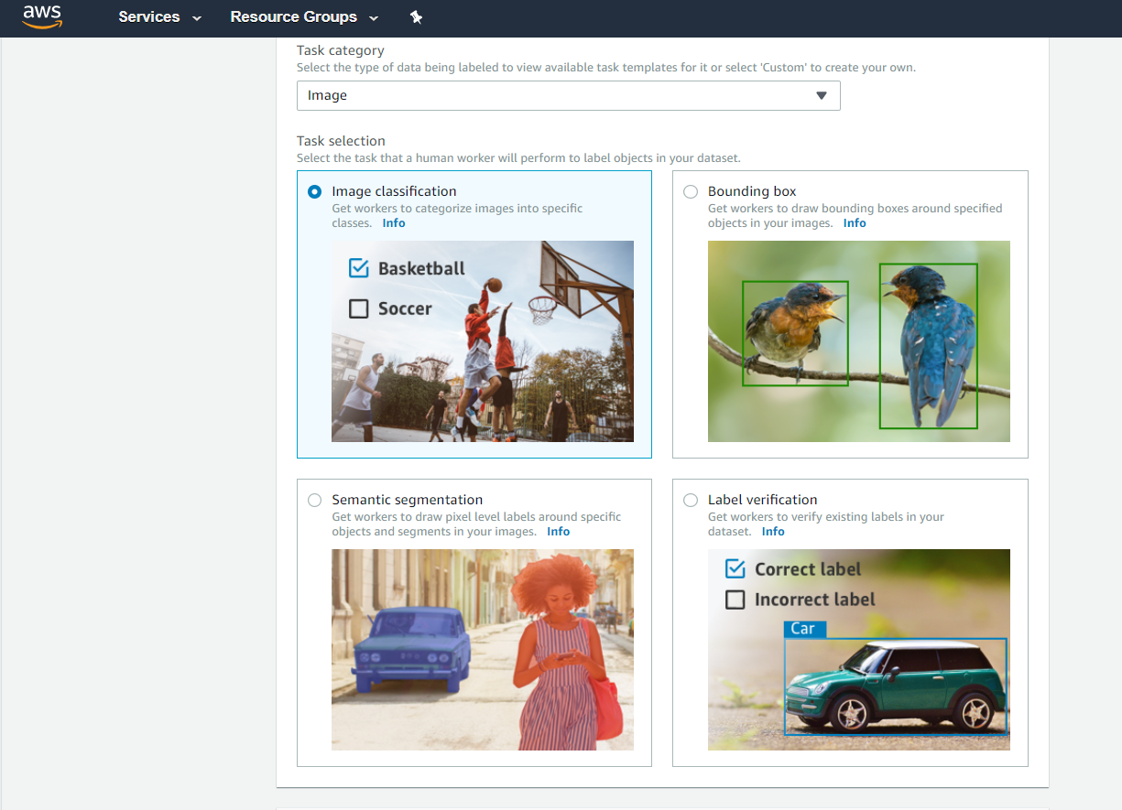

SAGEMAKER GROUNDTRUTH 101
AWS SageMaker GroundTruth is a service offered by AWS to label data.
In machine learning terminology, Ground truth means “gold standard”!
Ground Truth indicates the “true” or “real” class that you would like your model to learn how to predict.
AMAZON SAGEMAKER GROUNDTRUTH

Slide 4
GROUNDTRUTH KEY LABELING TASKS AND FEATURES
Several labeling tasks are available in SageMaker GroundTruth:
Bounding boxes
Image Classification
Semantic Segmentation
Text Classification
Custom Tasks
Check this out: https://aws.amazon.com/sagemaker/data-labeling/features/

Slide 5
AVAILABLE DATA LABELING WORKFORCES
Public Mechanical Turks: Amazon SageMaker facilitates the interaction between customers who require data labeling and an on-demand 24x7 global workforce of 500K contractors globally.
Private: A team of labelers can be specified by the customer including their own private labelers. Everything is managed through SageMaker Ground Truth. No need for labelers to have IAM or Amazon account.
Vendors: SageMaker Groundtruth provides a curated third-party vendors who can offer data labeling services.

Slide 6
21st CENTURY NEW GOLD
EASY
ADVANCED

Slide 7

WHY DATA IS CONSIDERED THE NEW GOLD OF THE 21st CENTURY?
The data revolution is here! Data is the new gold of the 21st Century.
Companies nowadays have access to a massive amount of data and their competitive advantage lies in their ability to gain valuable insights from this data.
Data can empower companies to boost their revenues, improve processes and reduce costs.
Data could be leveraged in many industries such as finance, banking, healthcare, transportation, and technology sectors.
Image Source: https://www.flickr.com/photos/tao_zhyn/442965594

Slide 8


DATA-DRIVEN SUCCESS STORIES
Netflix leverages customer data to recommend new content to users using its data-driven recommender system which earns it ~$1B USD in customer retention.
Amazon integrated data-driven recommendations at every stage of the purchasing process which resulted in 29% sales increase to $12.83 billion during its second fiscal quarter 2020, up from $9.9 billion during same time last year”.
Source: https://medium.com/eleks-labs/4-powerful-use-cases-for-data-science-in-finance-35d50075ff80
Source: https://emerj.com/ai-sector-overviews/ai-in-banking-analysis/
Source: https://www.precisely.com/blog/big-data/beyond-big-data-examples-success
Photo: https://commons.wikimedia.org/wiki/File:Logonfx.png
Photo: https://commons.wikimedia.org/wiki/File:Amazon_PNG6.png

Slide 9
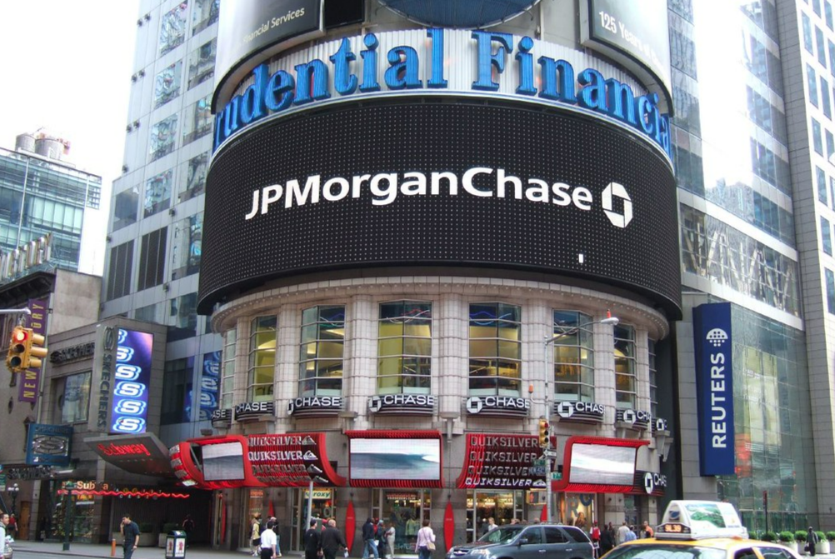

DATA-DRIVEN SUCCESS STORIES
“JP Morgan invests $11.5 billion/year in new data driven technologies. Its machine learning-based Contract Intelligence (COiN) platform reviews 12,000 commercial loan agreements in few hours compared to 360,000 man-hours it would take to do so manually.”
“Banking institutions prevented $22 billion worth of fraudulent transactions in 2018 with the power of AI/ML”.
“Bank of America introduced Erica chatbot that served 6 million users as of March 2019.”
Electronic trades account for almost 45% of revenues in cash equities trading” U.K. research firm Coalition Report.
Source: https://medium.com/eleks-labs/4-powerful-use-cases-for-data-science-in-finance-35d50075ff80
Source: https://emerj.com/ai-sector-overviews/ai-in-banking-analysis/
Source: https://www.precisely.com/blog/big-data/beyond-big-data-examples-success
Photo: https://www.flickr.com/photos/bensutherland/178395814
Photo: https://www.flickr.com/photos/moneyblognewz/5280927344

Slide 10
CORPORATE INTELLIGENCE WITH AI
Artificial intelligence is the science that empowers computers to mimic human intelligence such as decision making, text processing, and visual perception.
In order to train Artificial intelligence and Machine Learning models, companies need a massive amount of data.
DATA
THIS WILL BE OUR FOCUS! WE WILL LEARN HOW TO LABEL, CLEAN, CONCATENATE, MERGE, AND VISUALIZE THE DATA USING PANDAS AND THEN LEARN HOW TO DO THIS IN AWS SAGEMAKER
MODEL
COMPUTE
Photo Credit: https://www.flickr.com/photos/mikemacmarketing/30212411048

Slide 11
DATA SOURCES AND TYPES
EASY
ADVANCED

Slide 12

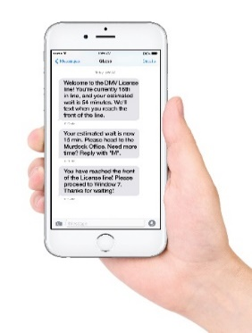



DATA SOURCES
Data can come from so many sources and forms such as images, audio, video, and text.
Collecting, structuring and analysing this data is critical for companies to gain customers insights and set their marketing and product strategies.
“Data preparation accounts for about 80% of the work of data scientists”, Forbes.
IMAGE/VIDEO
TEXT (CORPUS)
AUDIO/SOUND
TIMESERIES/SIGNALS
Source: https://www.forbes.com/sites/gilpress/2016/03/23/data-preparation-most-time-consuming-least-enjoyable-data-science-task-survey-says/?sh=410bbd6a6f63
Photo Credit: https://pxhere.com/en/photo/1454351
Photo Credit: https://www.flickr.com/photos/29881930@N00/2086641598
Photo Credit: https://commons.wikimedia.org/wiki/File:Mobile_phone_text_messages.jpg
Photo Credit: https://en.wikipedia.org/wiki/File:Messages_Yosemite.svg
Photo Credit: https://www.pexels.com/photo/blue-and-yellow-graph-on-stock-market-monitor-159888/

Slide 13


DATA TYPES: LABELED VS. UNLABELED DATASET
There are generally two types of data that we could use to train AI models.
UNLABELED DATASET
LABELED DATASET
LABEL = “CAT”
LABEL = “DOG”
Unlabeled data consists of data that does not have explanation (class or tag) associated with it.
Labeled data consists of unlabeled data but with a “class” or “tag” associated with it.
Photo Credit: https://www.pexels.com/photo/grey-and-white-short-fur-cat-104827/
Photo Credit: https://www.pexels.com/photo/portrait-of-a-dog-257540/

Slide 14
GOOD Vs. BAD DATA
GOOD DATA
BAD DATA
Many samples (large number of data points)
Not Biased
Does not contain missing data points
Only contains (relevant) important features
Does not contain duplicate samples
Few samples (small number of data points)
Biased
Contains missing data points
Contains many irrelevant (useless) features
Contains duplicate samples

Slide 15
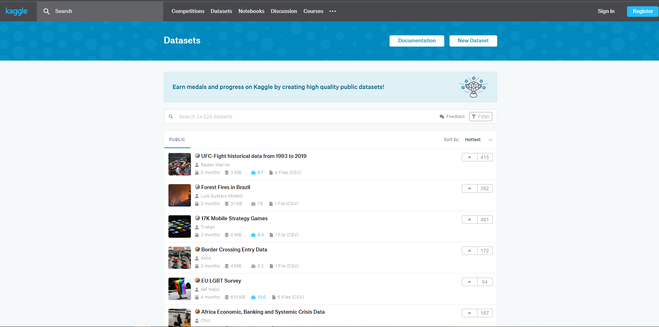
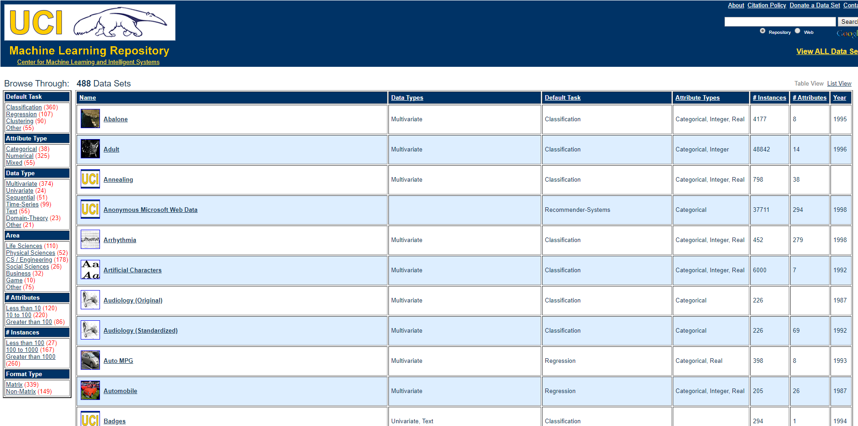
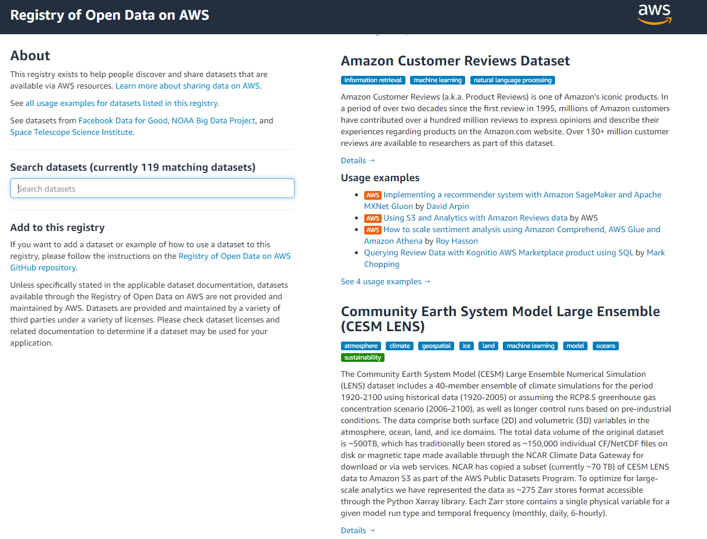
WHERE DOES THIS DATA COME FROM?
Data could also come from multiple sources such as Kaggle, UCI, and AWS Dataset.
ImageNet is an open source repository of images consisting of 21,841 subcategories (classes) and over 14 million images.
AWS dataset registery: https://registry.opendata.aws/
Check out website here: https://archive.ics.uci.edu/ml/datasets.php
Check out website here: https://www.kaggle.com/datasets

Slide 16
WHY DO WE NEED LABELED DATA?
EASY
ADVANCED

Slide 17
ML TRAINING STRATEGIES
Supervised Learning
Used in cases where large dataset with known labels (outputs) are available.
Unsupervised Learning
Used with "unlabeled" data (not categorized) (Ex: k-means clustering).
Reinforced Learning
Learning algorithm takes actions that maximizes cumulative reward.
The learning algorithm evaluates output (i.e.: makes predictions), compares output against the label, and adjust model weights/parameters and repeat.
Since learning algorithm works with unlabeled data, there is no way to assess the accuracy of the structure suggested by the algorithm
Over time, ML models learn to prefer the right kind of action and avoid the wrong one.

Slide 18
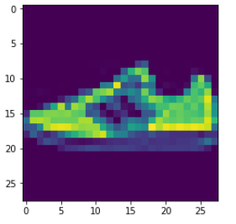
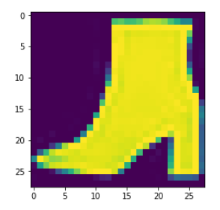
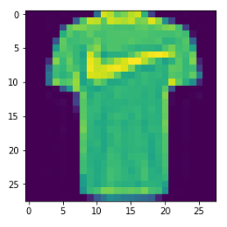
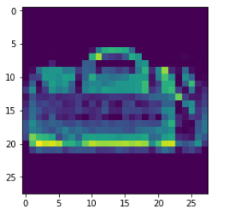
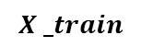
MACHINE LEARNING: SUPERVISED LEARNING
Supervised: used to train algorithms using labeled input and output data.
Performance is assessed by comparing trained model prediction vs. real output.
Labeled data is required for supervised ML applications.
DESIRED OUTPUT
TARGET CLASSES (LABELS)
y _train
INPUT DATA
$$X _train$$
T-SHIRT/TOP
TROUSER
PULLOVER
DRESS
COAT
SANDAL
SHIRT
SNEAKER
BAG
ANKLE BOOT
MODEL

Slide 19
MACHINE LEARNING: UNSUPERVISED LEARNING
Unsupervised learning: provides the algorithm with no labeled data.
The algorithm attempts at discovering hidden patterns within the training data.
Unsupervised learning methods can analyze complex data that humans might find difficult to interpret.
No feedback!
DATA CLUSTERS
INPUT DATA
MODEL

Slide 20
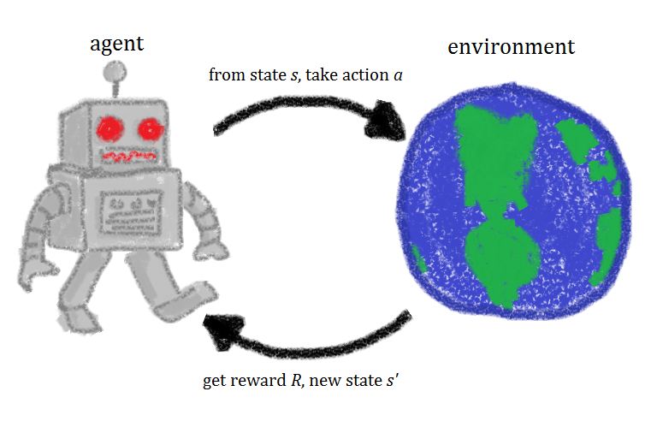



MACHINE LEARNING: REINFORCEMENT LEARNING
Reinforcement learning allows machines take actions to maximize cumulative reward.
Reinforcement algorithms learn by trial and error through reward/penalty.
Two elements: environment and learning agent.
The environment rewards the agent for correct actions.
Based on the reward or penalty, agent improves its environment knowledge to make better decision.
ENVIRONMENT
AGENT
-10 Points
+10 Points
Photo Credit: https://commons.wikimedia.org/wiki/File:Rl_agent.png

Slide 21
DATA LABELING CHALLENGES & APPLICATIONS
EASY
ADVANCED

Slide 22
DATA LABELING CHALLENGES
Modern state of the art deep learning models require a massive amount of labeled datasets
Large team of Human labelers are required to do the labeling
Inherent biases in human labelers require controls/standardization
Most data scientists’ time is spent curating and labeling data

Slide 23
USE CASES OF DATA LABELING
Text Data Analysis (News and Social Media Feeds)
Manufacturing Services: identify defects from images
Self-Driving Cars: label pedestrians, vehicles and traffic devices
AI-powered precision Agriculture: Identify precise locations of crops vs. weeds from images

Slide 24
JSON LINES FORMAT & MANIFEST FILES
EASY
ADVANCED

Slide 25
JSON LINES (JSONL)
JSON Lines text format is a format used for storing structured data that could be processed one record at a time.
JSON Line format is generally used to store data labels.
{“Image 1”: “Cat”}
{“Image 2”: “Dog”}
{“Image 3”: “Lion”}

Slide 26
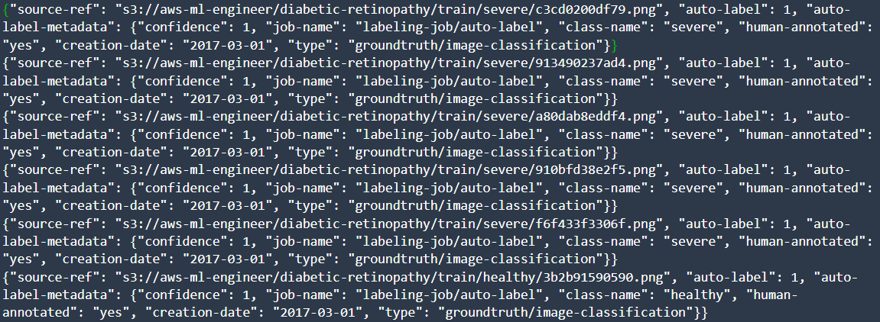
MANIFEST FILES 101
In computer vision classification-type problems (Supervised ML applications), a manifest file can be useful since it contains data about the inputs (images) and outputs (labels).
When you run an Amazon SageMaker GroundTruth Job, the output from this process includes a manifest file.
Manifest files are in JSON lines format where each line is a complete JSON object representing the labeling information for an image.
Each manifest file itself contains N JSON objects, where N is the number of images that are used in this dataset.

Slide 27
DATA LABELING IN SAGEMAKER GROUNDTRUTH DEMO – PART 1
EASY
ADVANCED

Slide 28
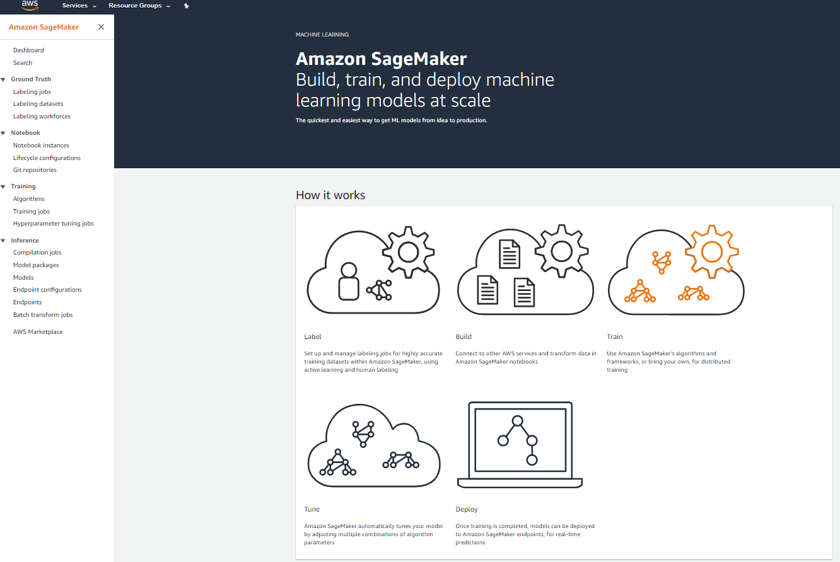
HOW TO OBTAIN LABELED DATA USING AWS? SAGEMAKER GROUNDTRUTH
YOU CAN CREATE LABELING JOBS USING AMAZON SAGEMAKER GROUND TRUTH SERVICE
https://aws.amazon.com/sagemaker/groundtruth/

Slide 29
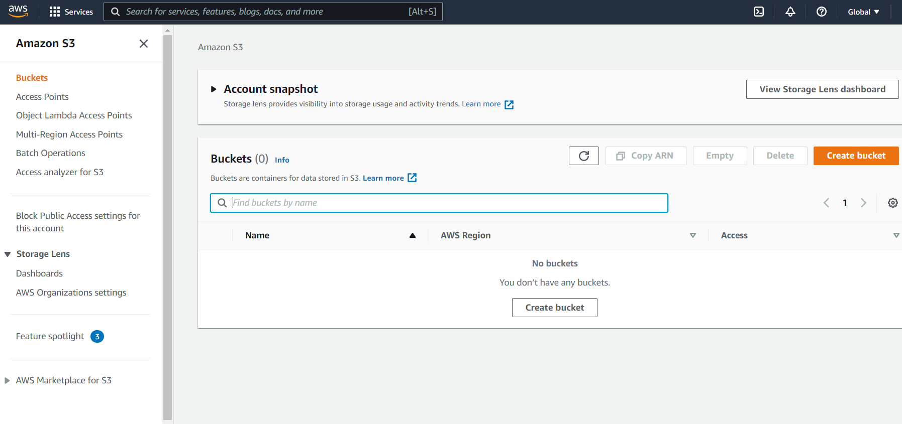
SAGEMAKER GOUNDTRUTH DEMO
UPLOAD IMAGES TO S3, GO TO S3 AND CLICK ON CREATE BUCKET

Slide 30
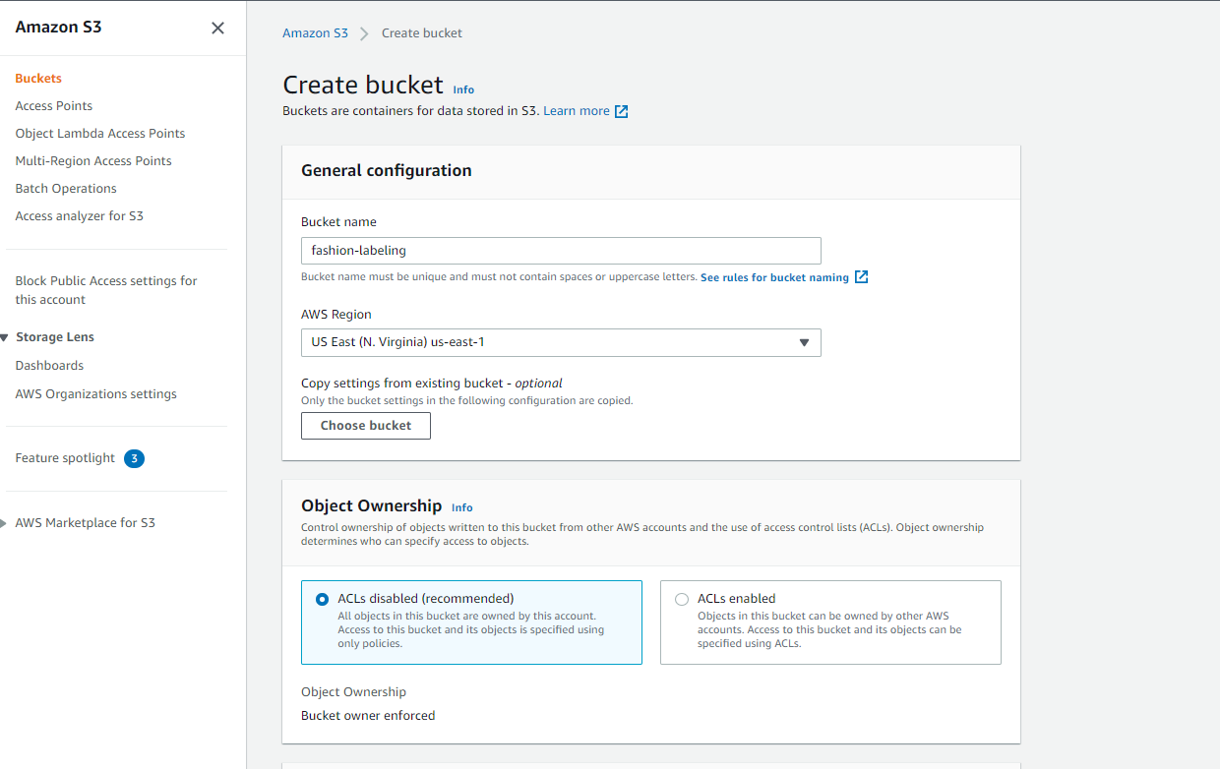
SAGEMAKER GOUNDTRUTH DEMO
GIVE IT NAME AND CLICK CREATE BUCKET
THEN UPLOAD IMAGES TO S3

Slide 31
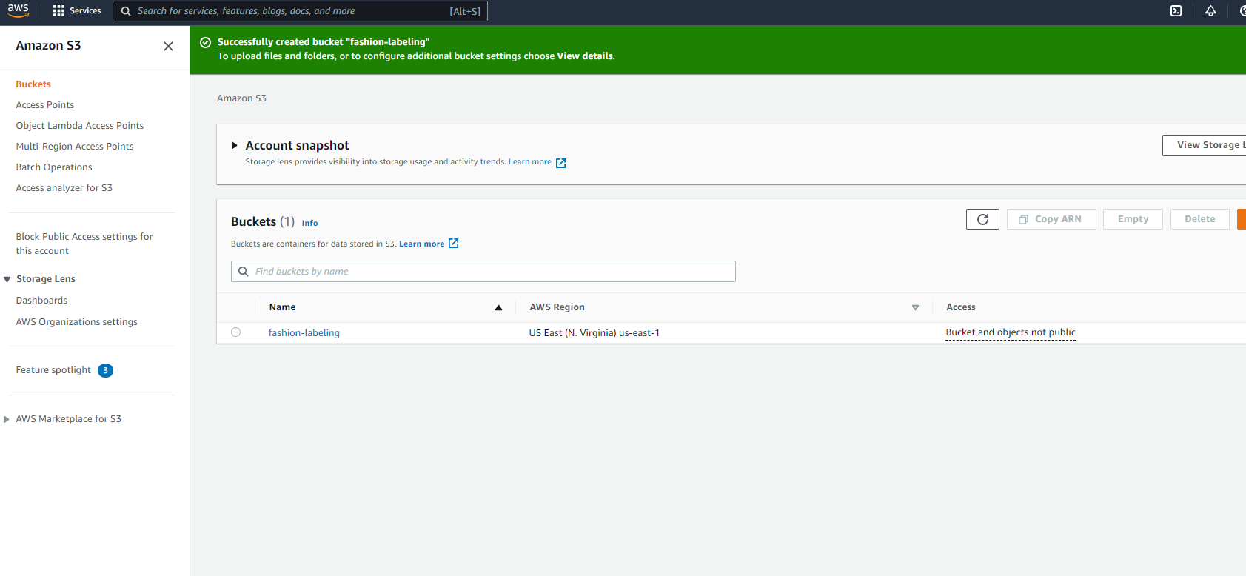
SAGEMAKER GOUNDTRUTH DEMO
CLICK ON THE NEWLY CREATED BUCKET
AND UPLOAD THE IMAGES

Slide 32
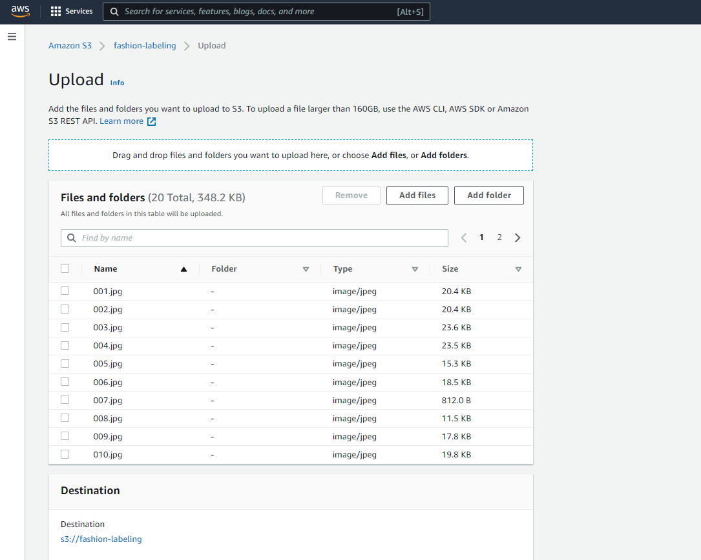
SAGEMAKER GOUNDTRUTH DEMO
CLICK UPLOAD

Slide 33
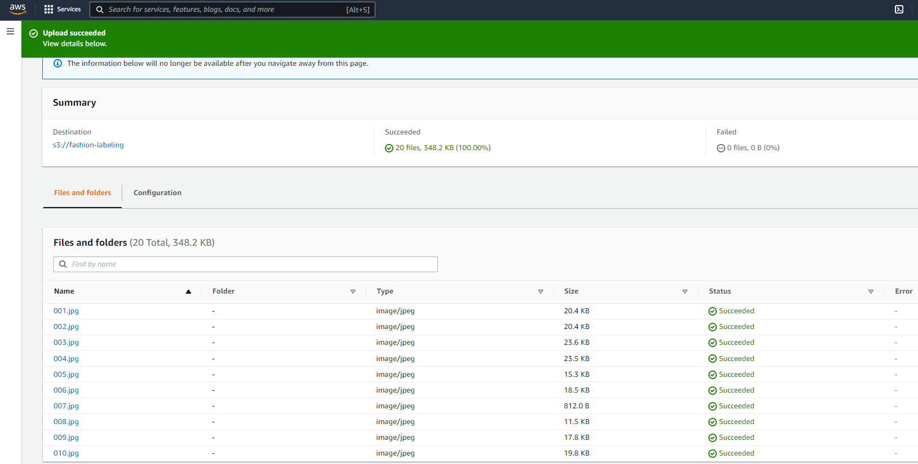
SAGEMAKER GOUNDTRUTH DEMO
IMAGES ARE NOW UPLOADED TO S3

Slide 34
SAGEMAKER GOUNDTRUTH DEMO
20 IMAGES BELONGS TO 4 CLASSES (BALANCED DATASET)
BAGS
EYEWEAR
FLIPFLOPS
WATCHES

Slide 35
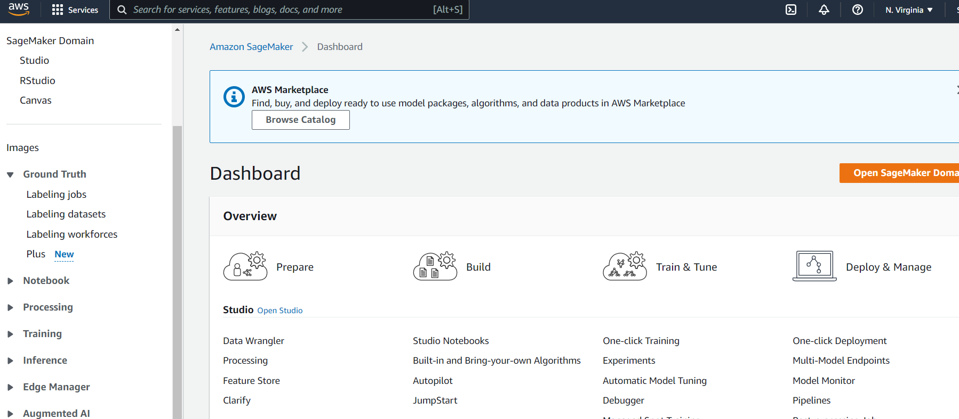
SAGEMAKER GOUNDTRUTH DEMO
OPEN SAGMAKER AND CLICK ON LABELING JOBS

Slide 36
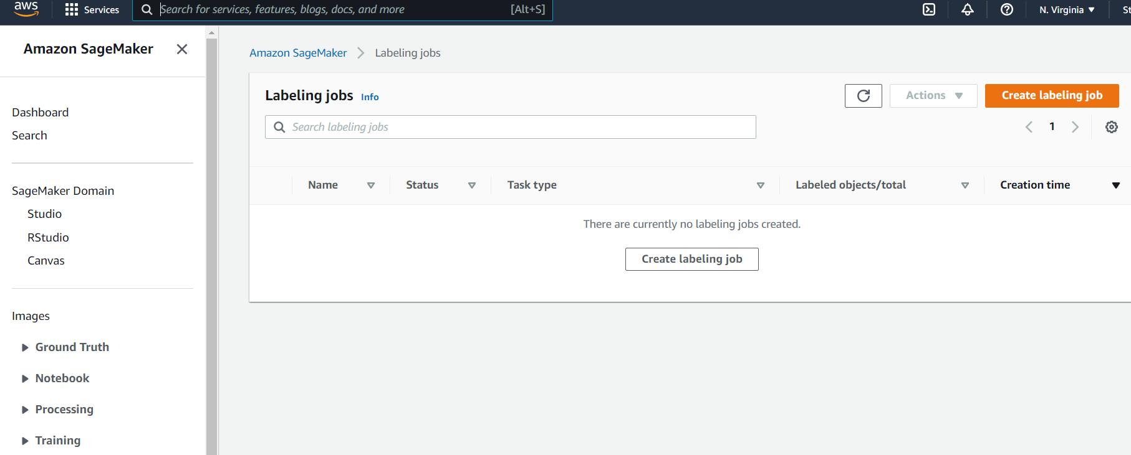
SAGEMAKER GOUNDTRUTH DEMO
CLICK ON CREATE LABELING JOB

Slide 37
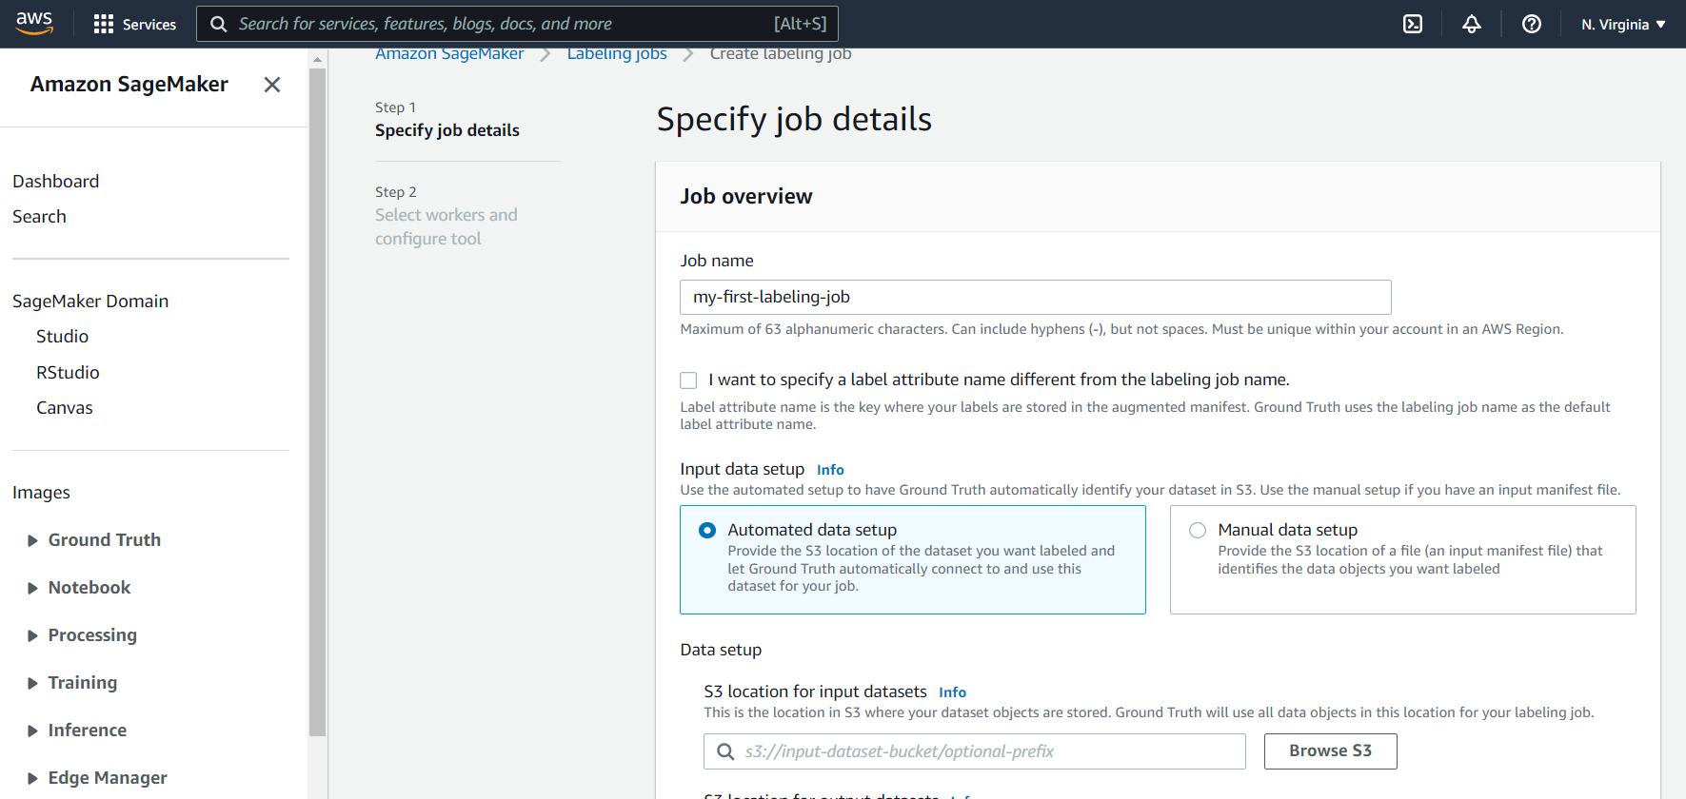
SAGEMAKER GOUNDTRUTH DEMO
GIVE A NAME TO THE JOB AND CLICK ON BROWSE S3

Slide 38
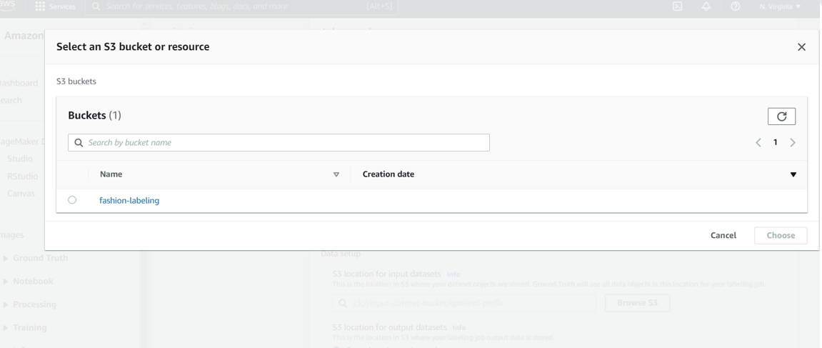
SAGEMAKER GOUNDTRUTH DEMO
CLICK ON BROWSE S3 AND POINT TO THE DATASET

Slide 39
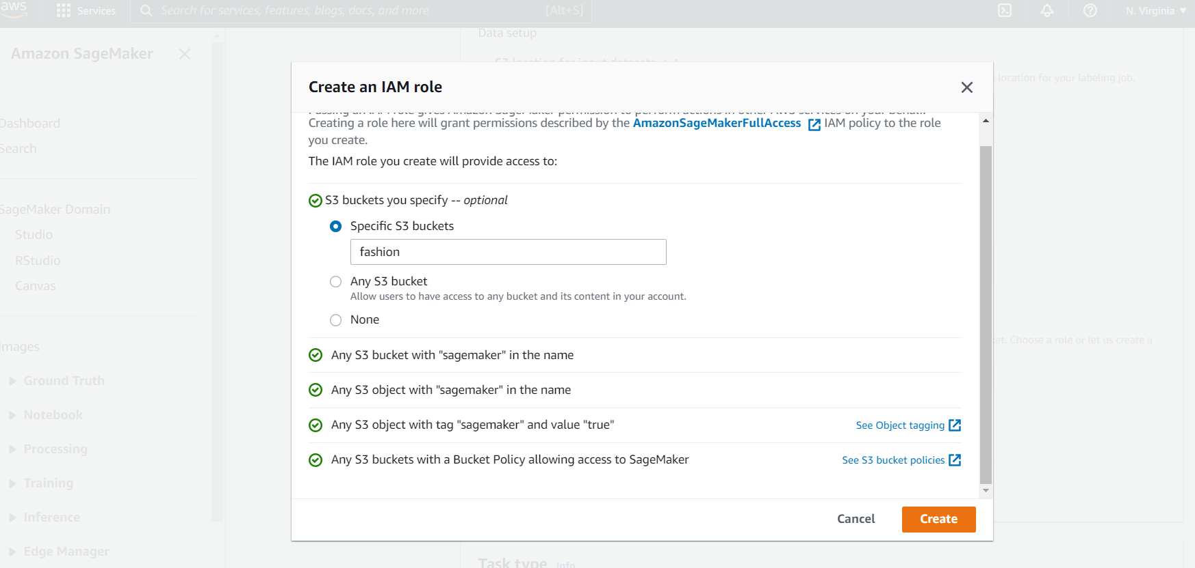
SAGEMAKER GOUNDTRUTH DEMO
CREATE A NEW IAM ROLE AND GIVE ACCESS TO A SPECIFIC BUCKET

Slide 40
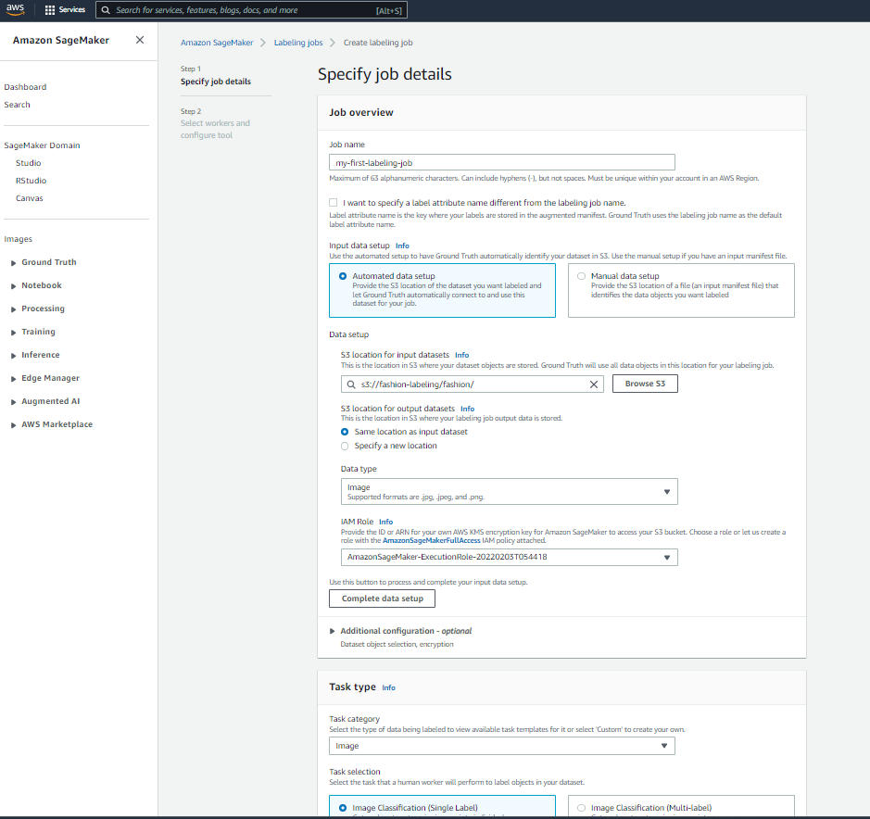
SAGEMAKER GOUNDTRUTH DEMO
A SUMMARY OF THE LABELING JOB

Slide 41
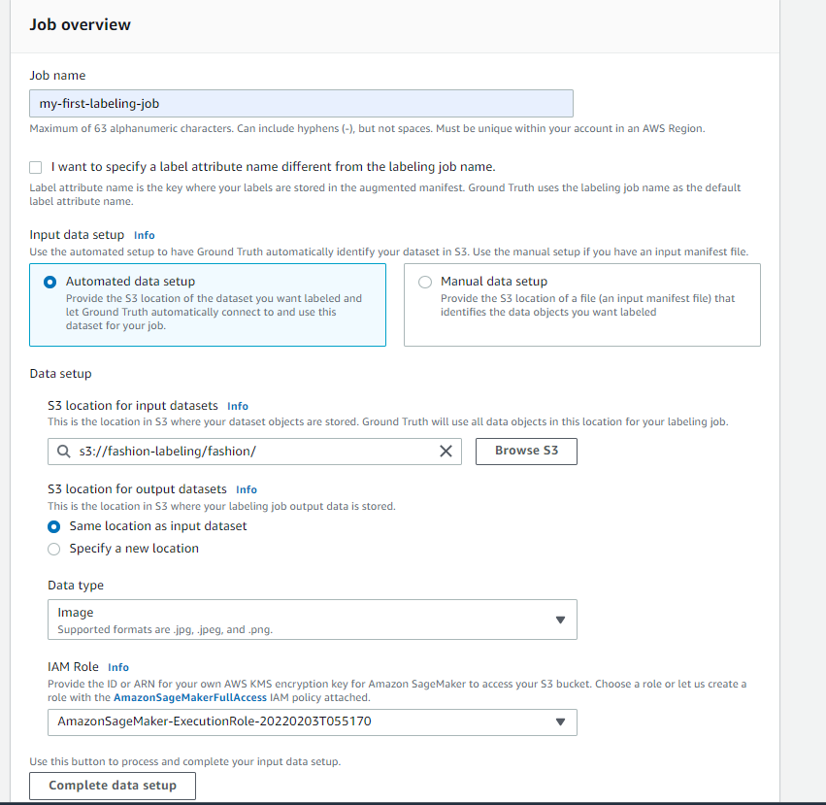
SAGEMAKER GOUNDTRUTH DEMO
DON’T FORGET TO CLICK ON “COMPLETE DATA SETUP”

Slide 42
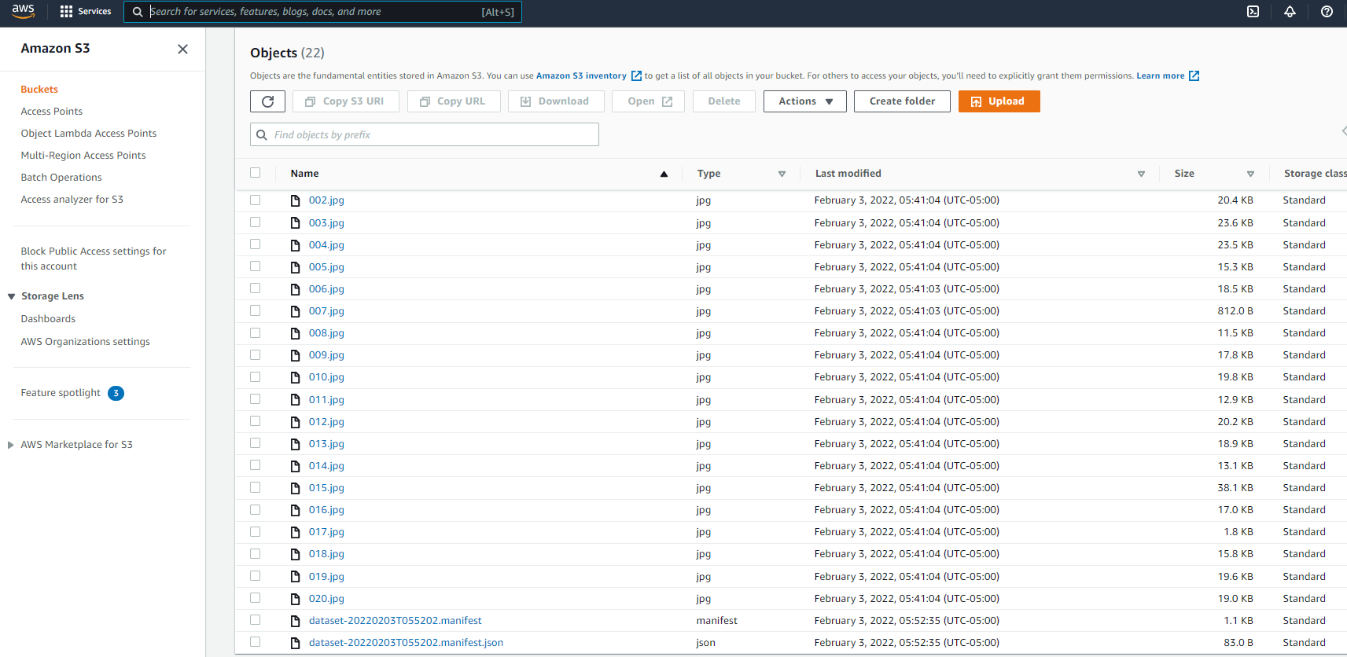
SAGEMAKER GOUNDTRUTH DEMO
WHEN YOU CLICK ON “COMPLETE DATA SETUP”, A MANIFEST FILE WILL BE GENERATED IN S3

Slide 43
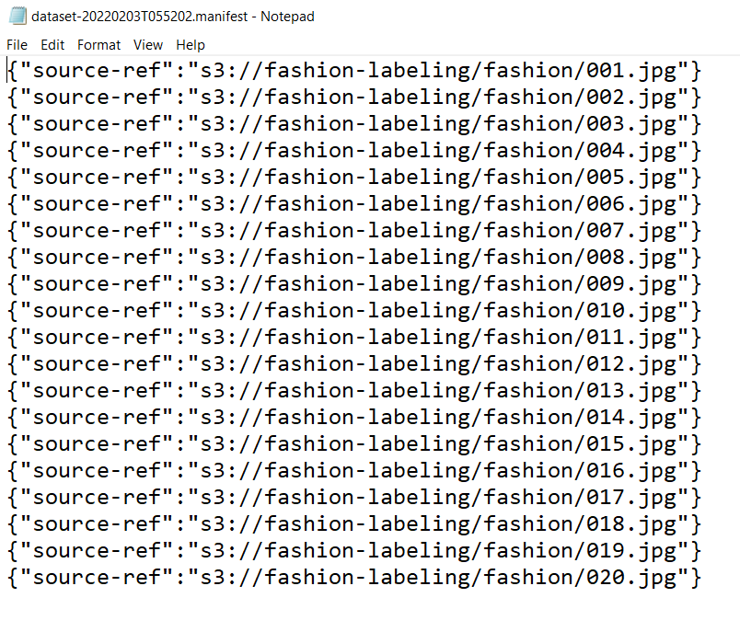
SAGEMAKER GOUNDTRUTH DEMO
INPUT MANIFEST FILE SHOULD LOOK LIKE THIS

Slide 44
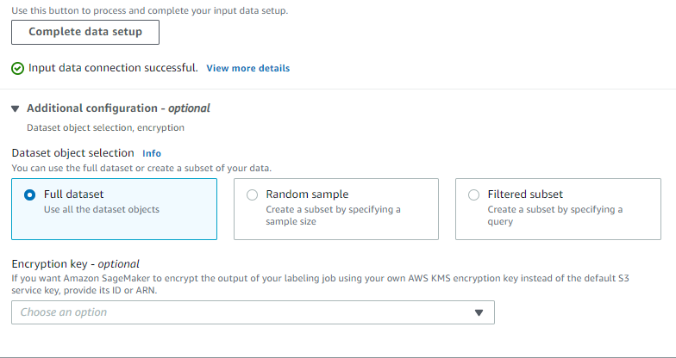
SAGEMAKER GOUNDTRUTH DEMO
NOTE THAT YOU CAN EITHER LABEL THE ENTRE DATASET OR CHOOSE A RANDOM SAMPLE

Slide 45
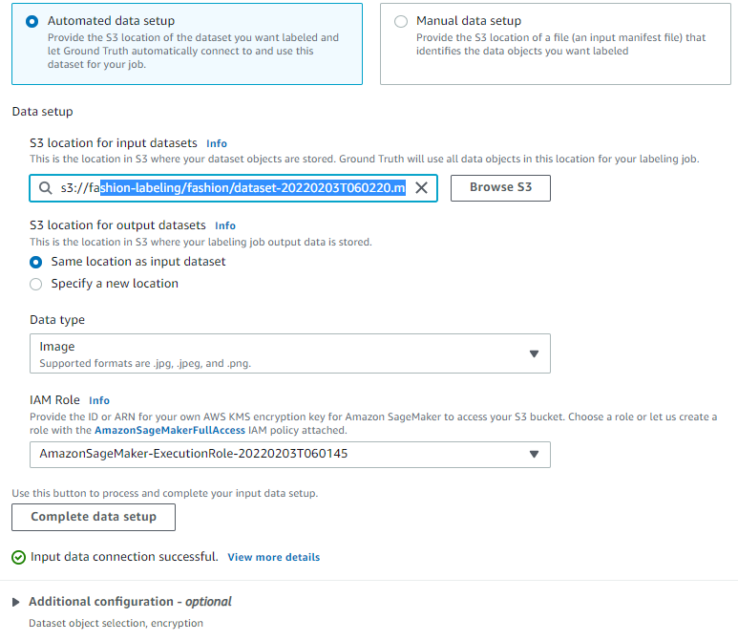
SAGEMAKER GOUNDTRUTH DEMO
NOTE THAT ONCE YOU ESTABLISH THE DATA CONNECTION, THE MANIFEST FILE PATH IS UPDATED AS SHOWN BELOW

Slide 46
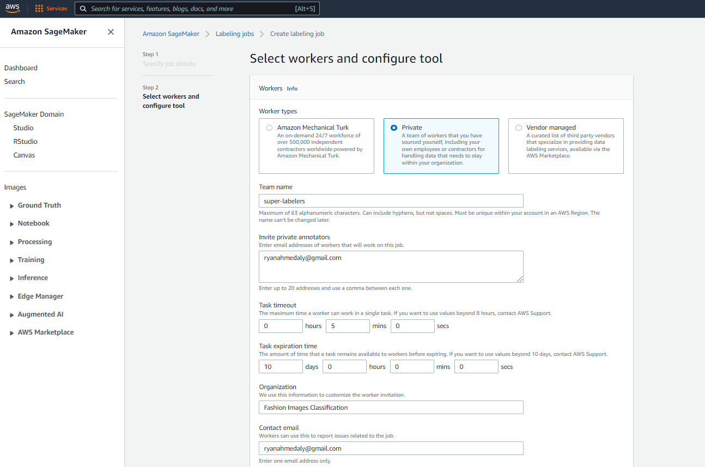
SAGEMAKER GOUNDTRUTH DEMO
LET’S KICK START A PRIVATE DATA LABELING JOB

Slide 47
DATA LABELING IN SAGEMAKER GROUNDTRUTH DEMO – PART 2
EASY
ADVANCED

Slide 48
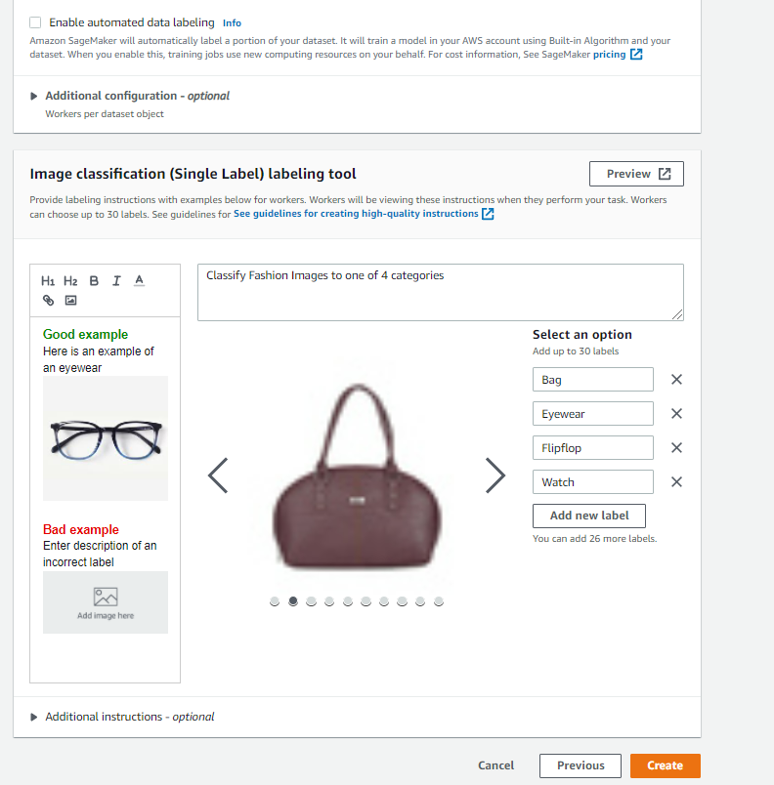
SAGEMAKER GOUNDTRUTH DEMO
SPECIFY THE LABELING JOB REQUIREMENTS

Slide 49
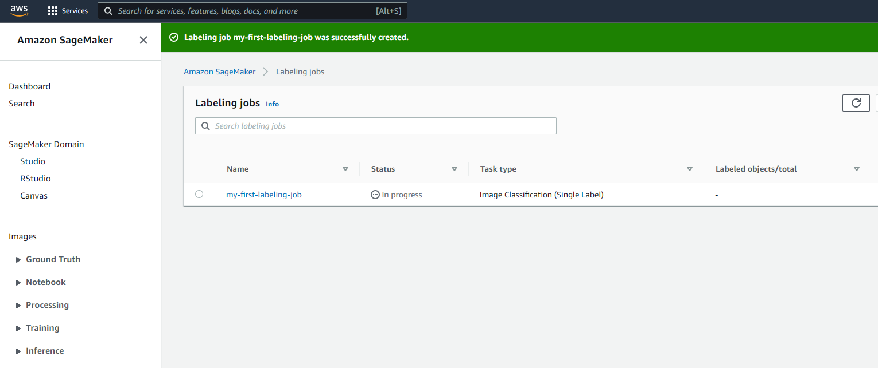
SAGEMAKER GOUNDTRUTH DEMO
NOTE THAT THE LABELING JOB HAS BEEN SUCCESSFULLY CREATED

Slide 50
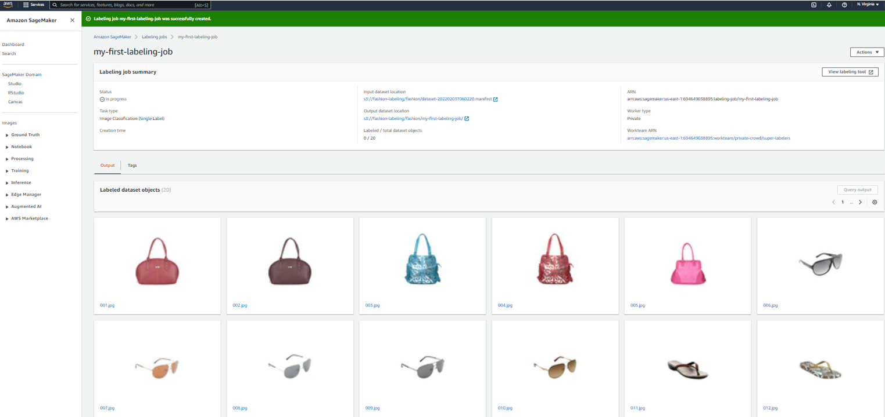
SAGEMAKER GOUNDTRUTH DEMO
CLICK ON THE LABELING JOB TO CHECK THE STATUS AND SEE IF IT MAKES SENSE!

Slide 51
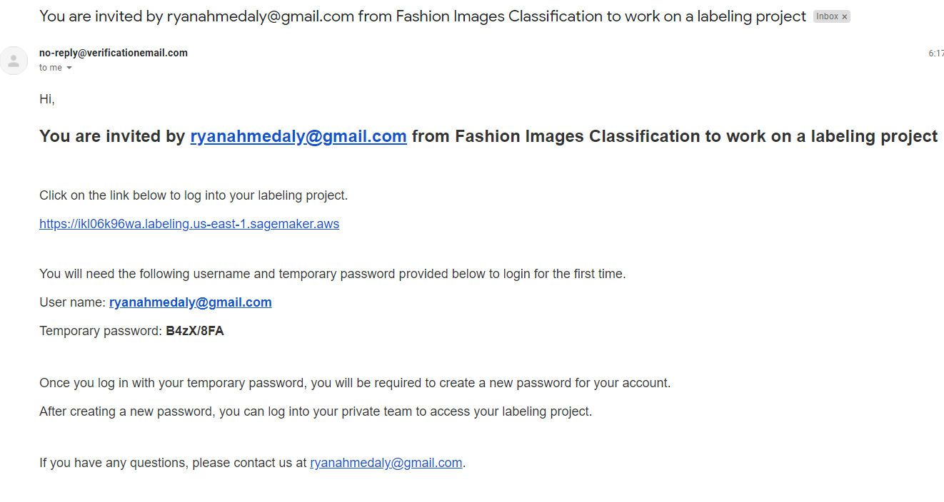
SAGEMAKER GOUNDTRUTH DEMO
THIS IS THE INVITE THAT LABELERS WILL RECEIVE IN THEIR EMAILS

Slide 52
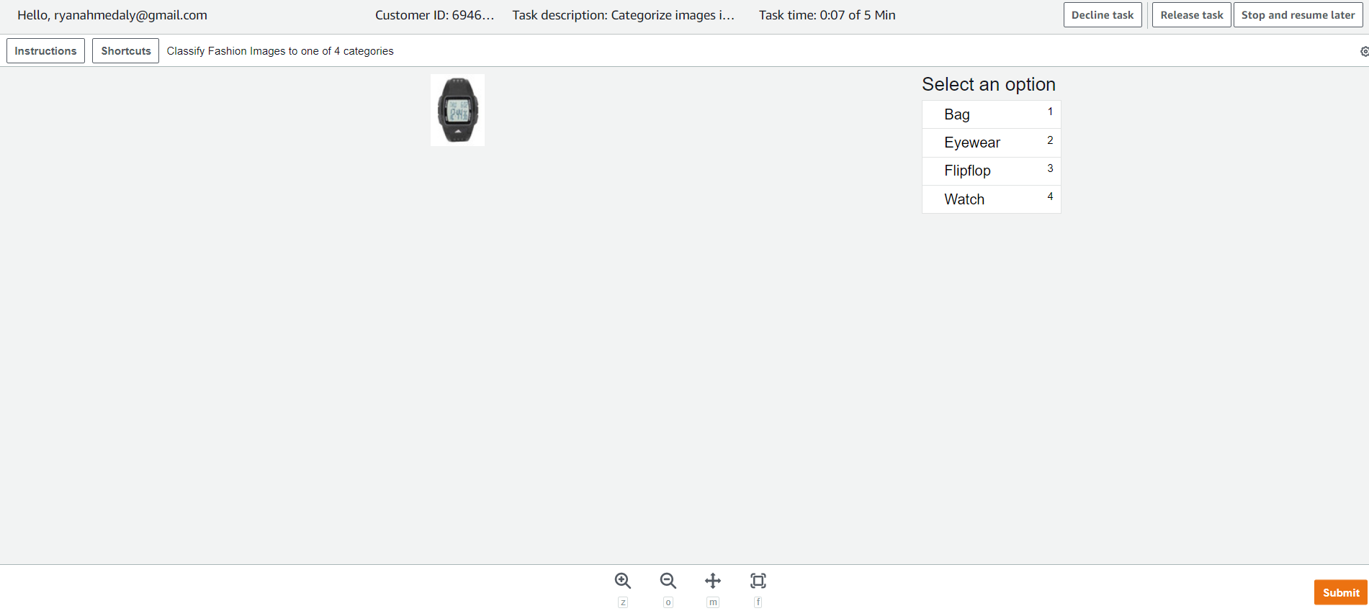
SAGEMAKER GOUNDTRUTH DEMO
THIS IS WHAT THE TASK LOOK LIKE!

Slide 53
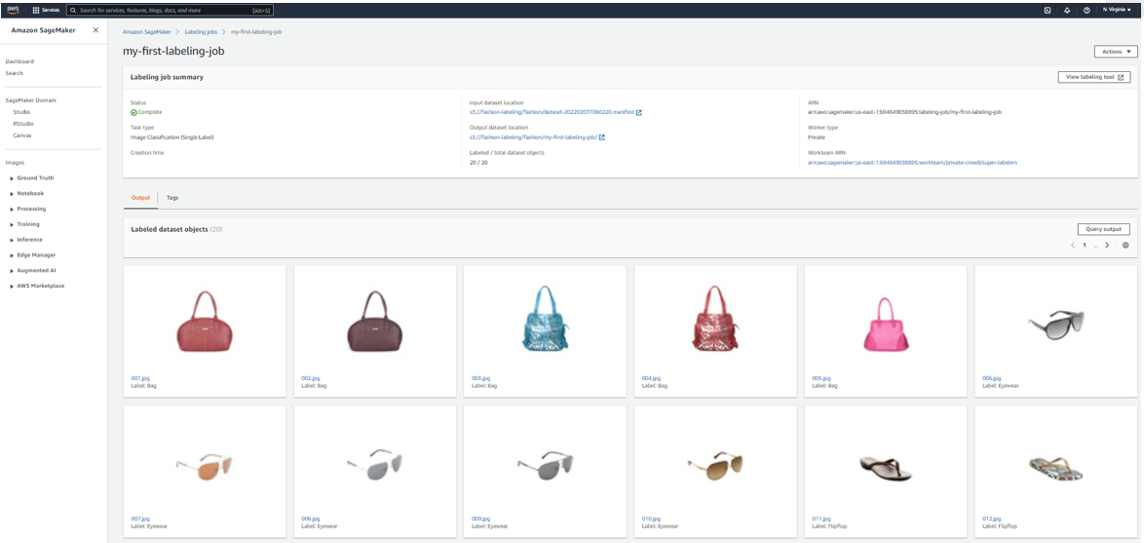
SAGEMAKER GOUNDTRUTH DEMO
THE LABELING JOB IS NOW COMPLETE, YOU CAN PROCEED WITH EXPLORING THE LABELS

Slide 54
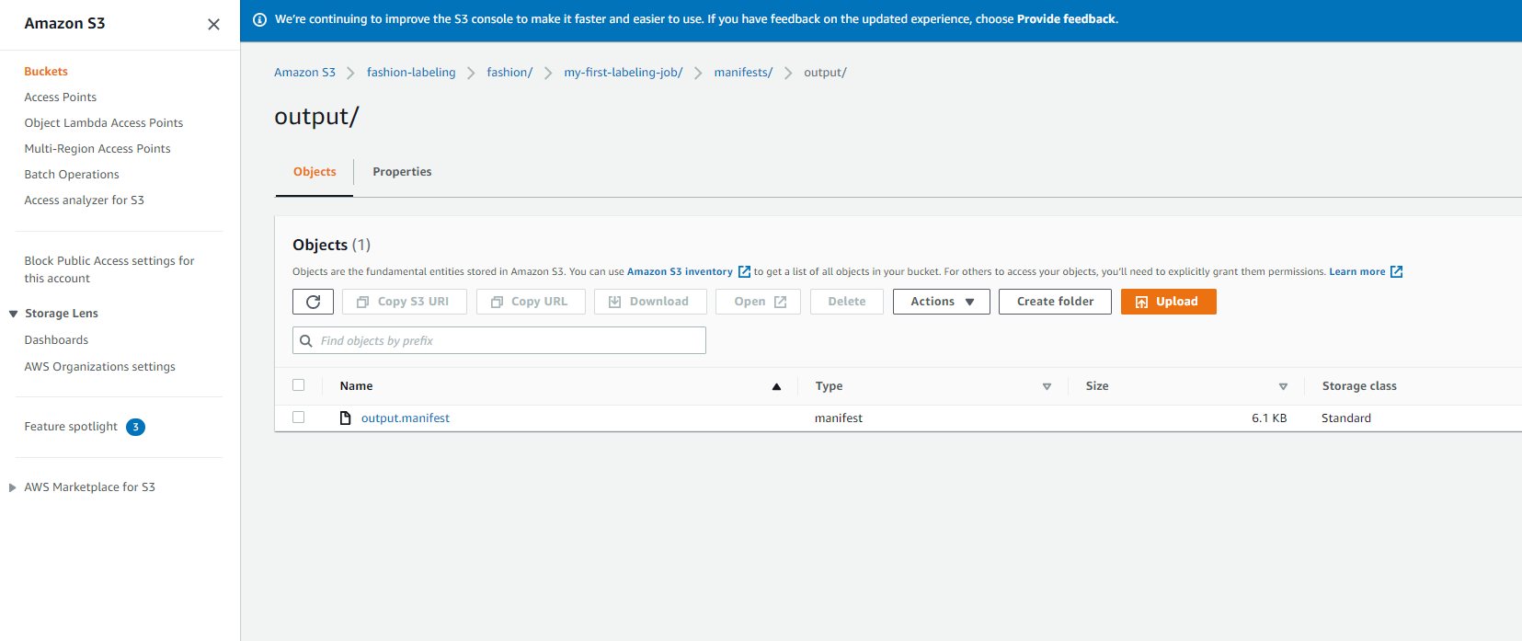
SAGEMAKER GOUNDTRUTH DEMO
GO TO S3 AND CHECK OUT THE MANIFEST OUTPUT FILE

Slide 55
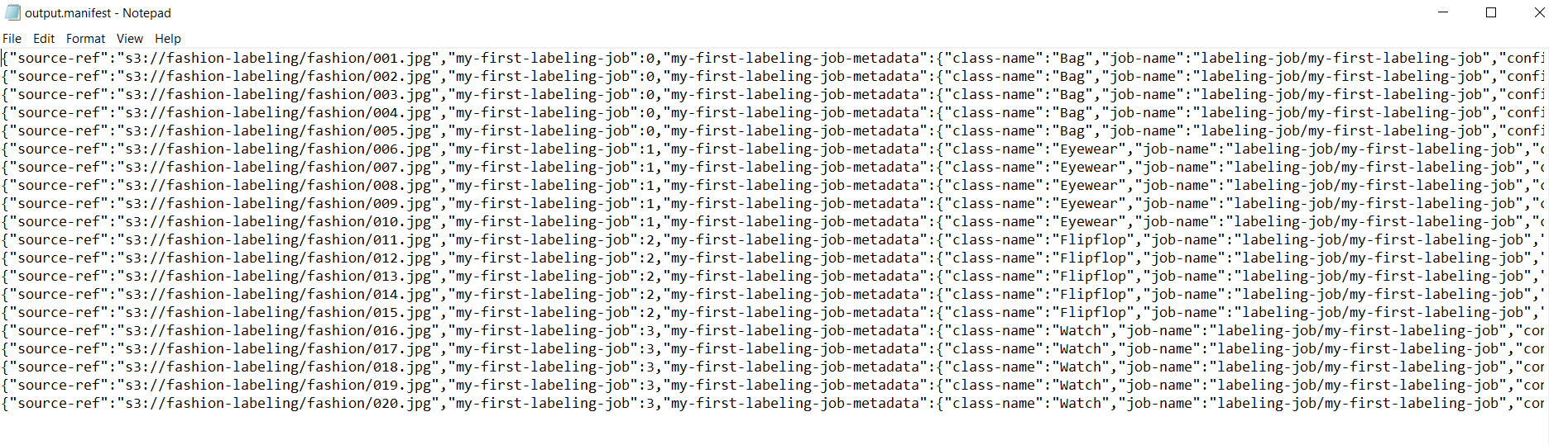
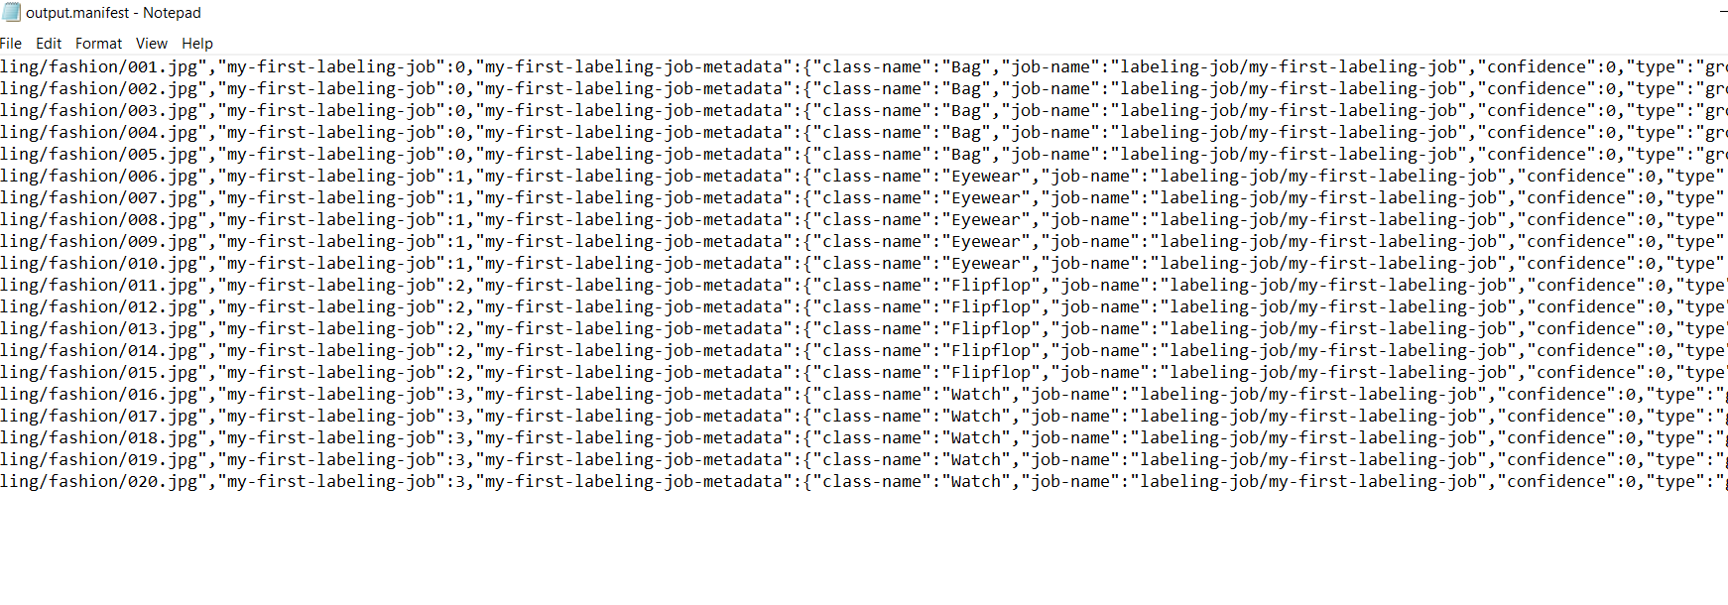
SAGEMAKER GOUNDTRUTH DEMO
CHECK OUT THE OUTPUT MANIFEST FILE. NOTE THAT CONFIDENCE IS SHOWN ZERO SINCE WE DON’T HAVE MULTIPLE LABELERS DOING THE SAME JOB AND WE DIDN’T LEVERAGE THE AUTOLABEL

Slide 56
FINAL END-OF-DAY CAPSTONE PROJECT
EASY
ADVANCED

Slide 57
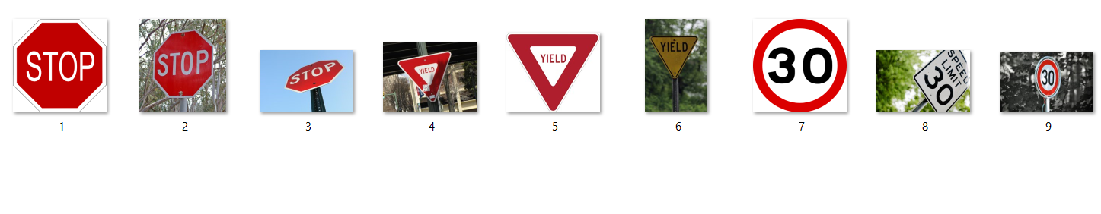
FINAL CAPSTONE PROJECT
Using the Traffic signs datasets included in the course package.
Create a labeling job using Amazon SageMaker GroundTruth
Review the input manifest file
Perform the labeling job
Review the output manifest file and ensure that the labeling job was successful
AWS SageMaker Pricing Examples: https://aws.amazon.com/sagemaker/data-labeling/pricing/?nc=sn&loc=3&refid=ps_a134p0000078pqxaae&trkcampaign=acq_paid_search_brand

Slide 58
FINAL END-OF-DAY CAPSTONE PROJECT SOLUTION
EASY
ADVANCED

Slide 59
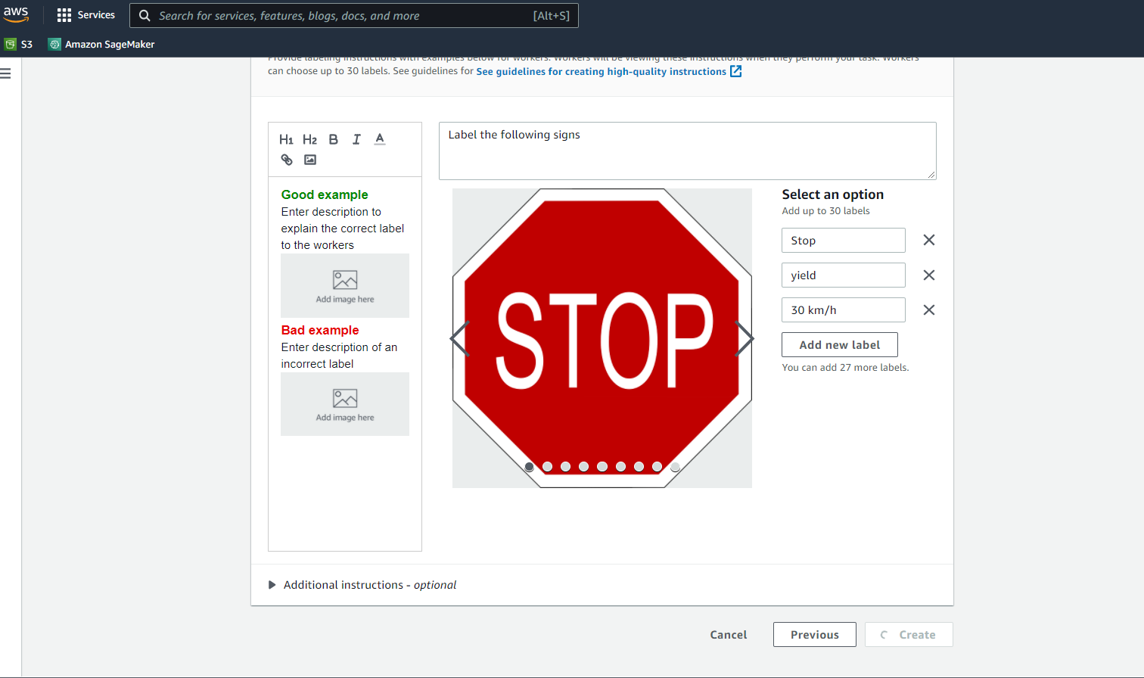
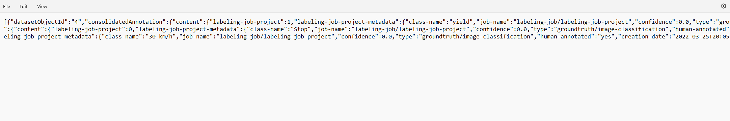
PROJECT SOLUTION

Slide 60
EXTRAS!
EASY
ADVANCED

Slide 61
GROUNDTRUTH VS. GROUNDTRUTH PLUS
AMAZON SAGEMAKER GROUND TRUTH
SAGEMAKER GROUND TRUTH PLUS
Amazon SageMaker ground truth empowers companies and individuals to build and manage data labeling workflows.
You need to manage human annotators such as mechanical turks, third-party vendors, or your own human labelers.
Amazon SageMaker Ground truth plus creates and manages the workflow on your behalf.
There is no need to manage workforces. Instead, a trained ML team will handle all data security, labeling, privacy and compliance.
It reduces data labeling costs by 40%
All what you need to do is to upload your datasets.

Slide 62
AUTOMATED DATA LABELING
Auto labeling uses active learning to determine if input data is well understood or not (Easy or hard).
Input unlabeled images are used with labeled output images to continuously train machine learning model which in turn reduces the number of human labelers required overtime (~70% reduction).
If there is no enough dataset, auto labeling is not recommended (threshold 1000 images)
HUMAN LABELERS
LABELED DATASETS
HARD EXAMPLES
CAT
UNLABELED DATASETS
ACTIVE LEARNING
AUTOLABELING
DOG
EASY EXAMPLES
MACHINE LEARNING MODELS
Photo Credit: https://www.pexels.com/photo/grey-and-white-short-fur-cat-104827/
Photo Credit: https://www.pexels.com/photo/portrait-of-a-dog-257540/

